Slide 1

Visual C sharp® How to Program
Sixth Edition
Chapter 22
Databases and L I N Q
Copyright © 2017 Pearson Education, Inc. All Rights Reserved
Notes:
If this PowerPoint presentation contains mathematical equations, you may need to check that your computer has the following installed:
1) MathType Plugin
2) Math Player (free versions available)
3) NVDA Reader (free versions available)

Slide 2
Learning Objectives
Learn about the relational database model.
Use an A D O.NET Entity Data Model to create classes for interacting with a database via L I N Q to Entities.
Use L I N Q to retrieve and manipulate data from a database.
Add data sources to projects.
Use the I D E’s drag-and-drop capabilities to display database tables in apps.
Use data binding to move data seamlessly between G U I controls and databases.
Create Master/Detail views that enable you to select are cord and display its details.

Slide 3
Outline (1 of 2)
22.1 Introduction
22.2 Relational Databases
22.3 A Books Database
22.4 L I N Q to Entities and the A D O.NET Entity Framework
22.5 Querying a Database with L I N Q
22.5.1 Creating the A D O.NET Entity Data Model Class Library
22.5.2 Creating a Windows Forms Project and Configuring It to Use the Entity Data Model
22.5.3 Data Bindings Between Controls and the Entity Data Model
22.6 Dynamically Binding Query Results
22.6.1 Creating the Display Query Results G U I

Slide 4
Outline (2 of 2)
22.6.2 Coding the Display Query Results App
22.7 Retrieving Data from Multiple Tables with L I N Q
22.8 Creating a Master/Detail View App
22.8.1 Creating the Master/Detail G U I
22.8.2 Coding the Master/Detail App
22.9 Address Book Case Study
22.10 Tools and Web Resources
22.11 Wrap-Up

Slide 5
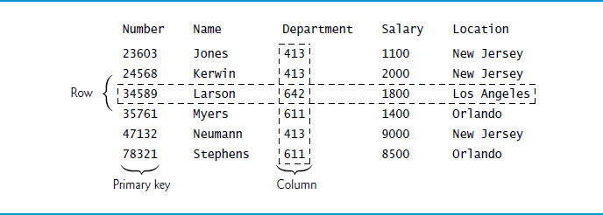
Figure 22.1 Employees Table Sample Data

Slide 6
Figure 22.2 Distinct Department and Location Data from the Employees Table
Department | Location
413 | New Jersey
611 | Orlando
642 | Los Angeles

Slide 7
Figure 22.3 Authors Table of the Books Database
Column | Description
AuthorID | Author’s ID number in the database. In the Books database, this integer column is defined as an identity column, also known as an autoincremented column—for each row inserted in the table, the AuthorID value is increased by 1 automatically to ensure that each row has a unique AuthorID. This is the primary key.
FirstName | Author’s first name (a string).
LastName | Author’s last name (a string).

Slide 8
Figure 22.4 Data from the Authors Table
AuthorID | FirstName | LastName
1 | Paul | Deitel
2 | Harvey | Deitel
3 | Abbey | Deitel
4 | Sue | Green
5 | John | Purple

Slide 9
Figure 22.5 Titles Table of the Books Database
Column | Description
I S B N | I S B N of the book (a string). The table’s primary key. ISBN is an abbreviation for “International Standard Book Number”—a numbering scheme that publishers worldwide use to give every book a unique identification number.
Title | Title of the book (a string).
EditionNumber | Edition number of the book (an integer).
Copyright | Copyright year of the book (a string).

Slide 10
Figure 22.6 Data from the Titles Table of the Books Database (1 of 2)
I S B N | Title | EditionNumber | Copyright
0132151006 | Internet & World Wide Web How to Program | 5 | 2012
0133807800 | Java How to Program | 10 | 2015
0132575655 | Java How to Program, Late Objects Version | 10 | 2015
0133976890 | C How to Program | 8 | 2016
0133406954 | Visual Basic 2012 How to Program | 6 | 2014
0134601548 | Visual C sharp How to Program | 6 | 2017
0134448235 | C++ How to Program | 10 | 2016
0134444302 | Android How to Program | 3 | 2016
0134289366 | Android 6 for Programmers: An App-Driven Approach | 3 | 2016

Slide 11
Figure 22.6 Data from the Titles Table of the Books Database (2 of 2)
I S B N | Title | EditionNumber | Copyright
0133965260 | I O S 8 for rogrammers: An App-Driven Approach with Swift | 3 | 2015
0134021363 | Swift for Programmers | 1 | 2015

Slide 12
Figure 22.7 AuthorI S B N Table of the Books Database
Column | Description
AuthorID | The author’s ID number, a foreign key to the Authors table.
I S B N | The I S B N for a book, a foreign key to the Titles table.

Slide 13
Figure 22.8 Data from the AuthorI S B N Table of the Books Database
AuthorID | I S B N
1 | 0132151006
1 | 0133807800
1 | 0132575655
1 | 0133976890
1 | 0133406954
1 | 0134601548
1 | 0134448235
1 | 0134444302
1 | 0134289366
1 | 0133965260
1 | 0134021363
2 | 0132151006
2 | 0133807800
AuthorID | I S B N
2 | 0132575655
2 | 0133976890
2 | 0133406954
2 | 0134601548
2 | 0134448235
2 | 0134444302
2 | 0134289366
2 | 0133965260
2 | 0134021363
3 | 0132151006
3 | 0133406954
4 | 0134289366
5 | 0134289366

Slide 14
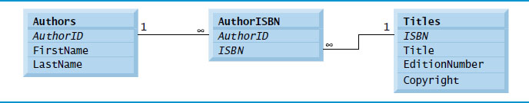
Figure 22.9 Entity-Relationship Diagram for the Books Database

Slide 15
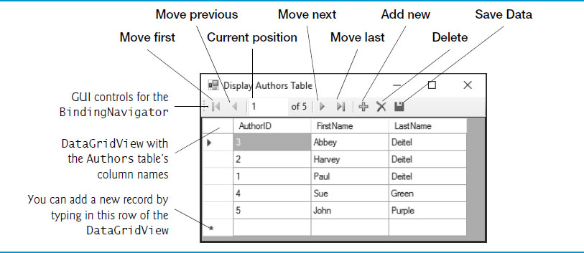
Figure 22.10 G U I for the Display Authors Table App

Slide 16
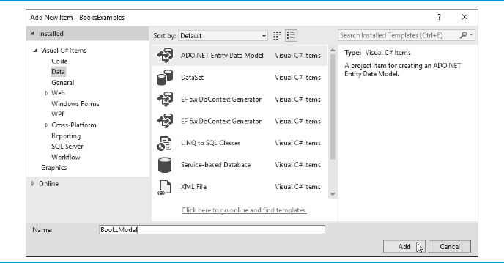
Figure 22.11 Selecting A D O.NET Entity Data Model in the Add New Item Dialog

Slide 17
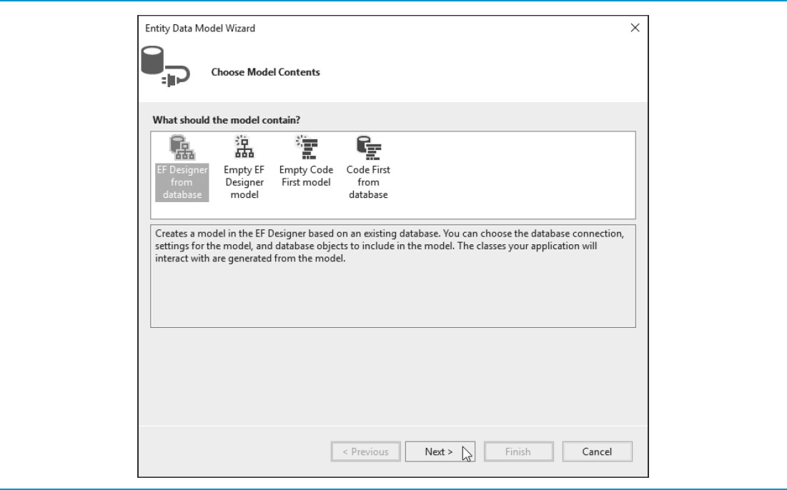
Figure 22.12 Entity Data Model Wizard Dialog’s Choose Model Contents Step

Slide 18
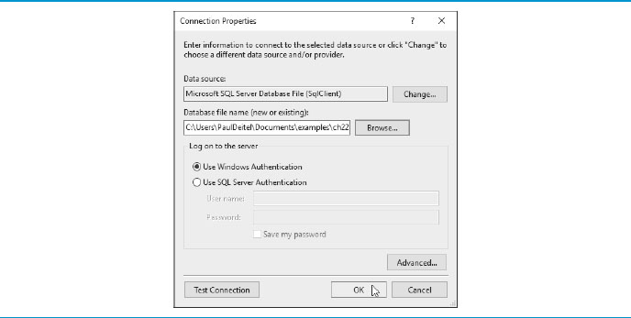
Figure 22.13 Connection Properties Dialog

Slide 19
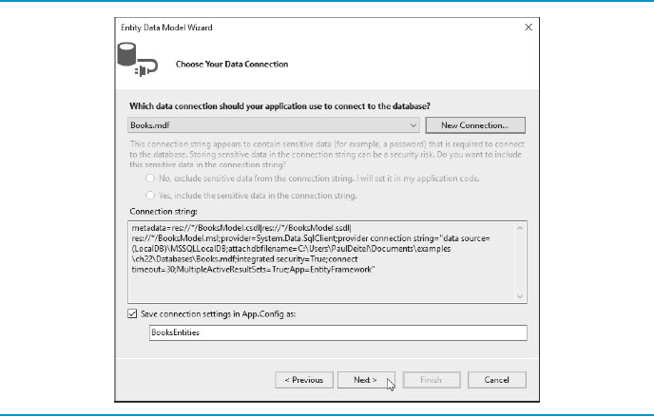
Figure 22.14 Choose Your Data Connection Step After Selecting Books.mdf

Slide 20
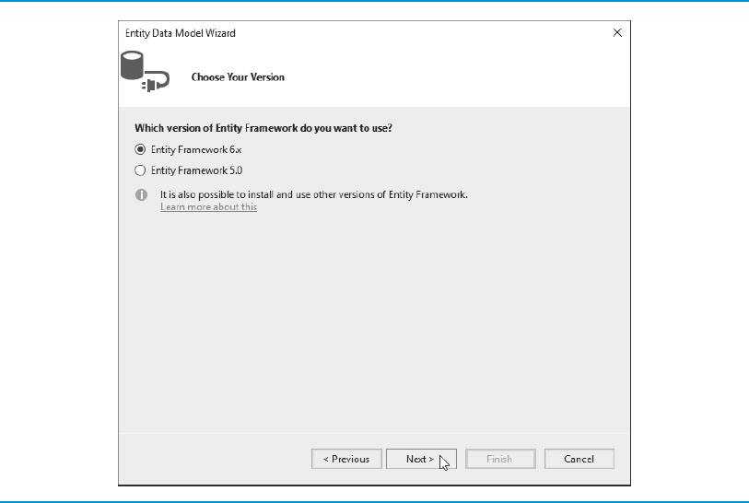
Figure 22.15 Choosing the Entity Framework Version to Use in the Project

Slide 21
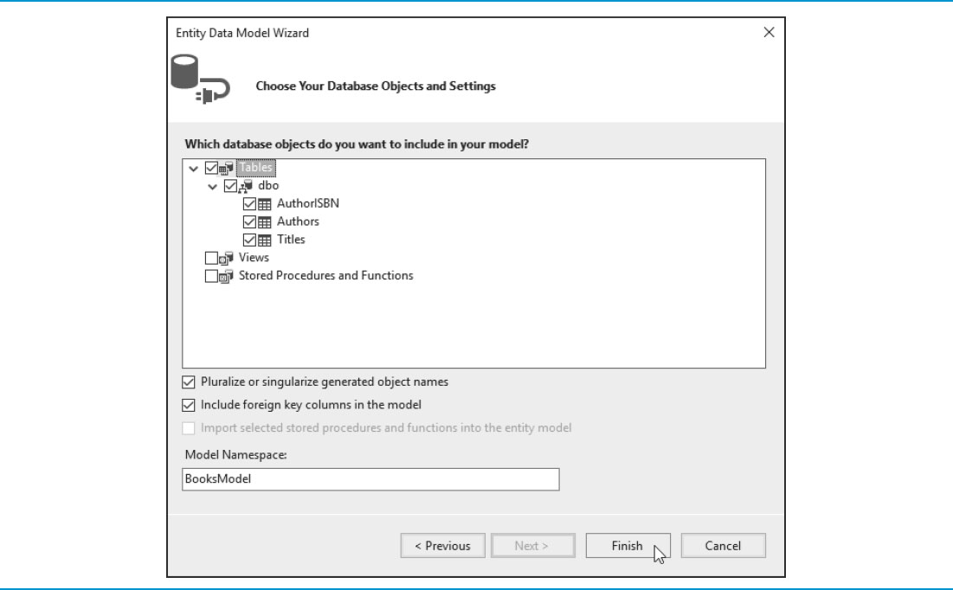
Figure 22.16 Selecting the Database’s Tables to Include in the A D O.NET Entity Data Model

Slide 22
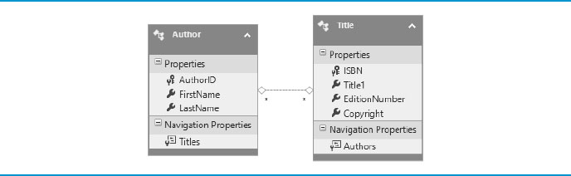
Figure 22.17 Entity Data Model Diagram for the Author and Title Entities

Slide 23
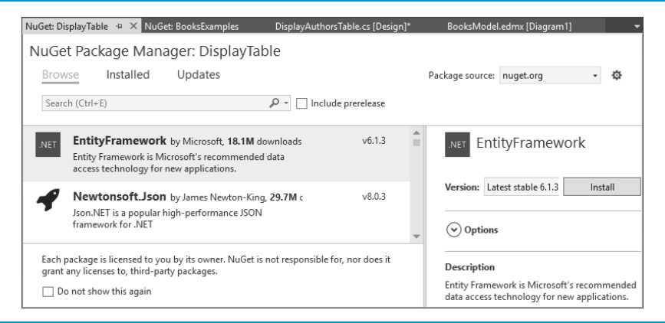
Figure 22.18 Selecting and Installing the EntityFramework in the NuGet Tab

Slide 24
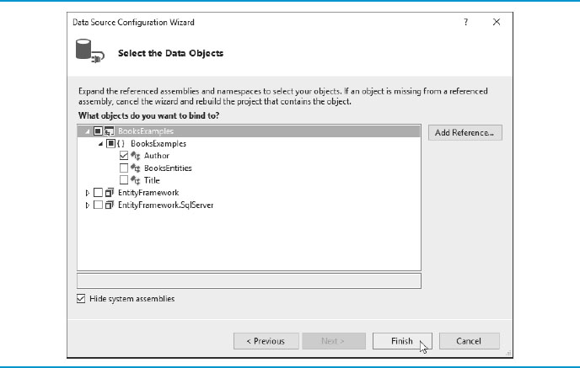
Figure 22.19 Selecting the Entity Data Model Class Author as the Data Source

Slide 25

Figure 22.20 Data Sources Window Showing the Expanded Author Class as a Data Source

Slide 26
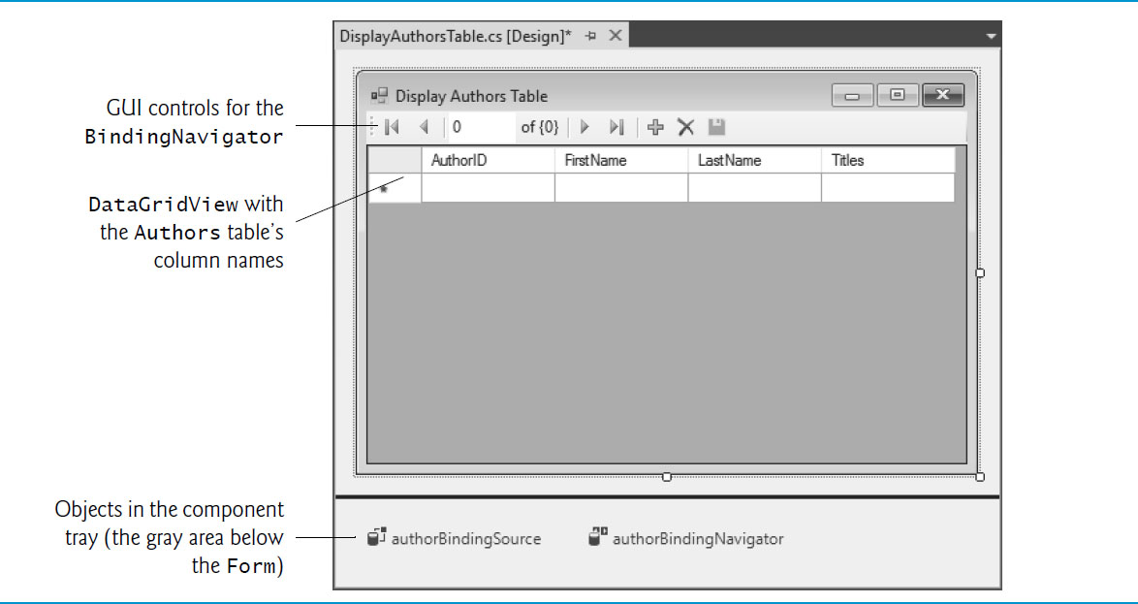
Figure 22.21 Component Tray Holds Nonvisual Components in Design View

Slide 27
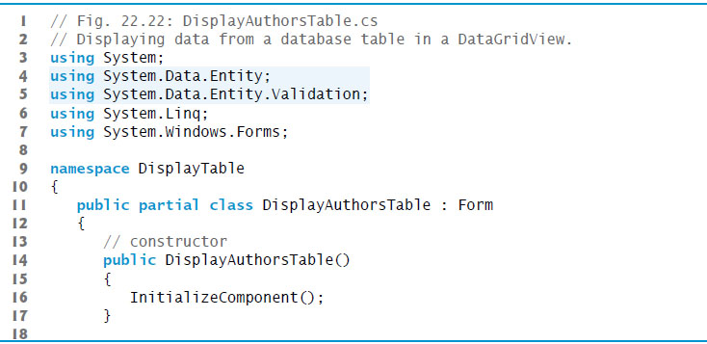
Figure 22.22 Displaying Data from a Database Table in a DataGridView (1 of 4)

Slide 28
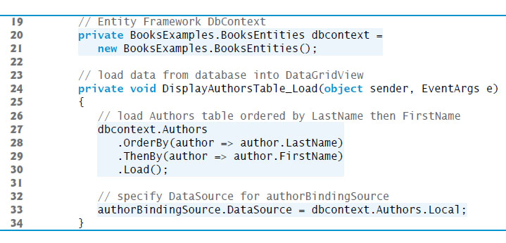
Figure 22.22 Displaying Data from a Database Table in a DataGridView (2 of 4)

Slide 29
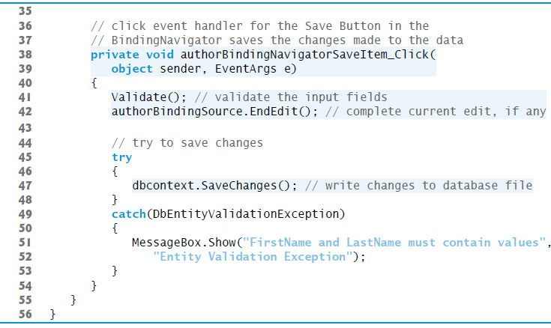
Figure 22.22 Displaying Data from a Database Table in a DataGridView (3 of 4)

Slide 30
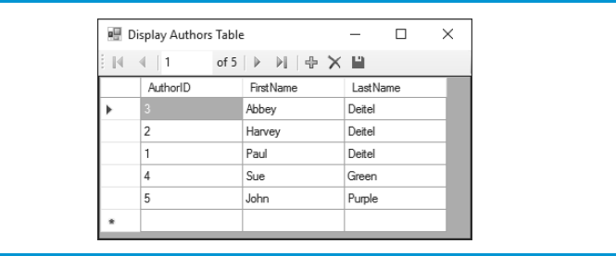
Figure 22.22 Displaying Data from a Database Table in a DataGridView (4 of 4)

Slide 31
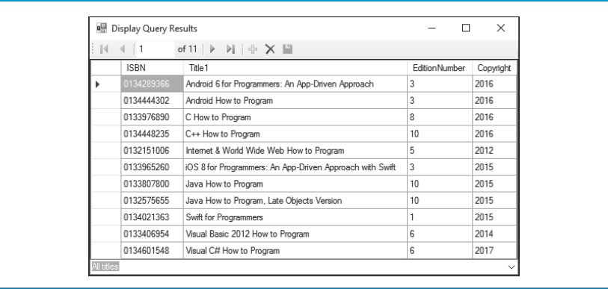
Figure 22.23 Results of the Display Query Results App’s All Titles Query, Which Shows the Contents of the Titles Table Ordered by the Book Titles

Slide 32
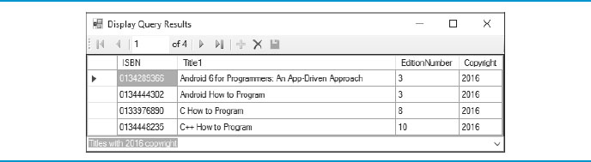
Figure 22.24 Results of the Display Query Results App’s Titles with 2016 Copyright Query

Slide 33
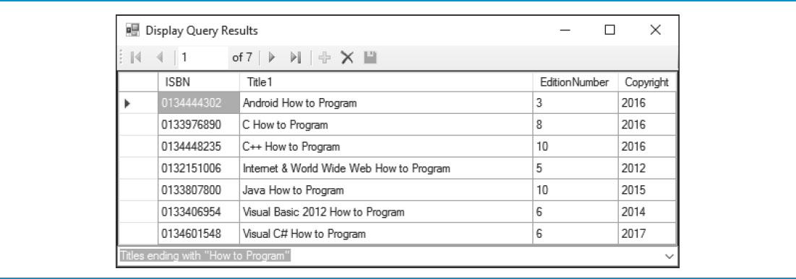
Figure 22.25 Results of the Display Query Results App’s Titles Ending With “How to Program” Query

Slide 34
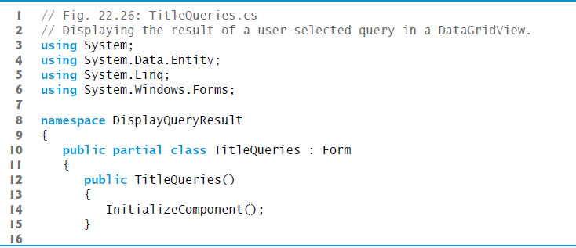
Figure 22.26 Displaying the Result of a User-Selected Query in a DataGridView (1 of 4)

Slide 35
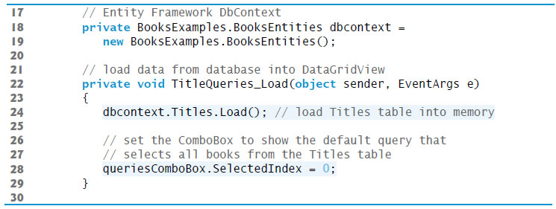
Figure 22.26 Displaying the Result of a User-Selected Query in a DataGridView (2 of 4)

Slide 36
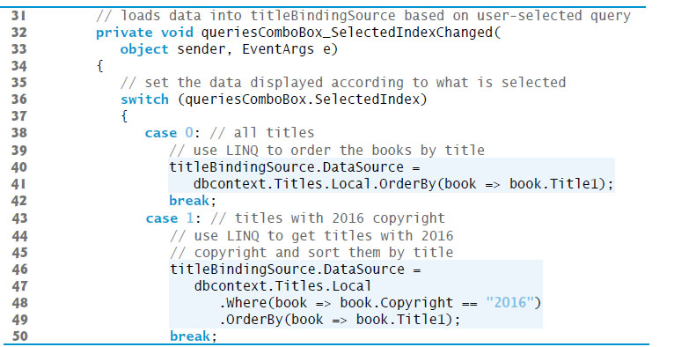
Figure 22.26 Displaying the Result of a User-Selected Query in a DataGridView (3 of 4)

Slide 37
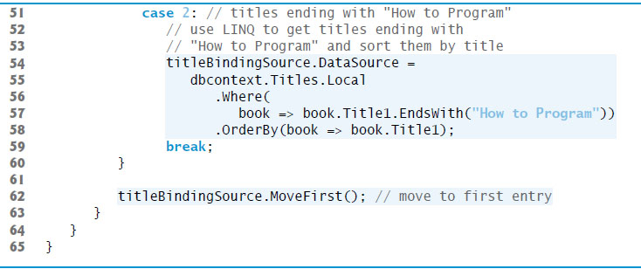
Figure 22.26 Displaying the Result of a User-Selected Query in a DataGridView (4 of 4)

Slide 38
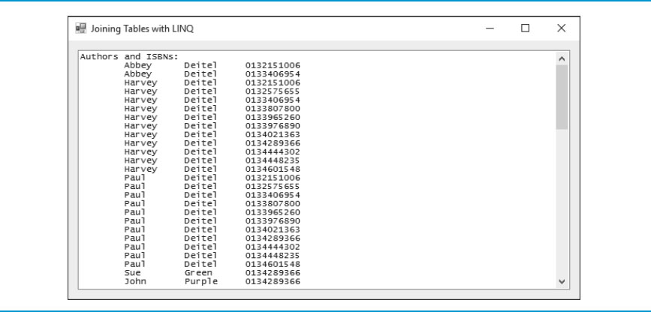
Figure 22.27 Joining Tables with L I N Q App Showing the List of Authors and the I S B N s of the Books They’ve Authored
The authors are sorted by last name, then first name.

Slide 39
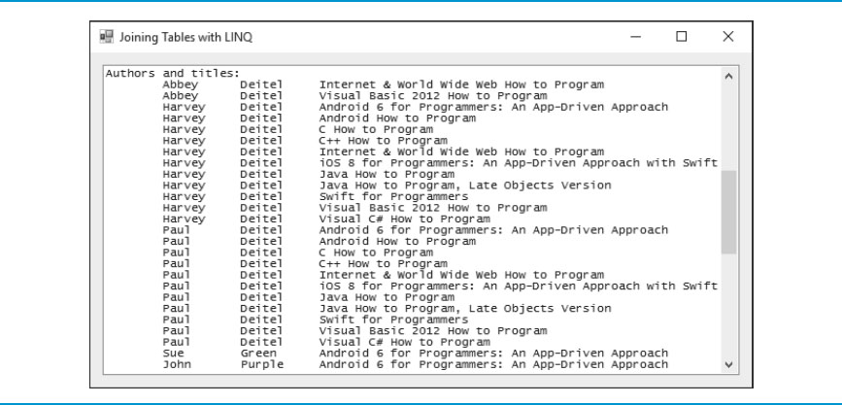
Figure 22.28 Joining Tables with L I N Q App Showing the List of Authors and the Titles of the Book’s They’ve Authored
The Authors Are Sorted by Last Name, Then First Name, and the Titles for a Given Author Are Sorted Alphabetically.

Slide 40
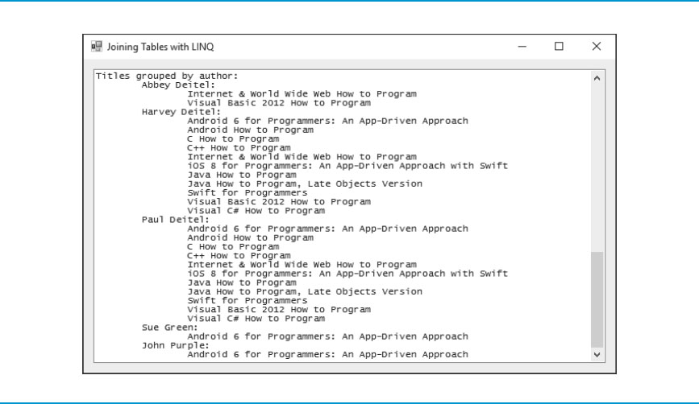
Figure 22.29 Joining Tables with L I N Q App Showing the List of Titles Grouped by Author
The Authors Are Sorted by Last Name, Then First Name, and the Titles for a Given Author Are Sorted Alphabetically.

Slide 41
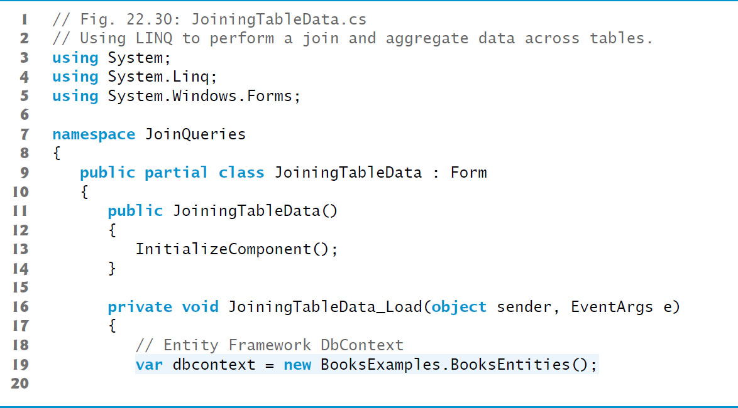
Figure 22.30 Creating the BooksEntities for Querying the Books Database

Slide 42
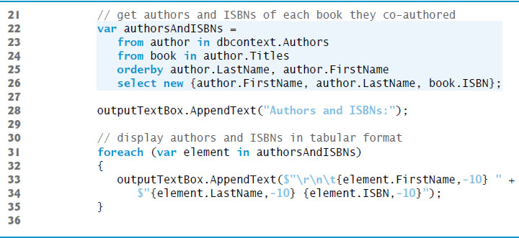
Figure 22.31 Getting a List of Authors and the I S B N s of the Books They’ve Authored

Slide 43
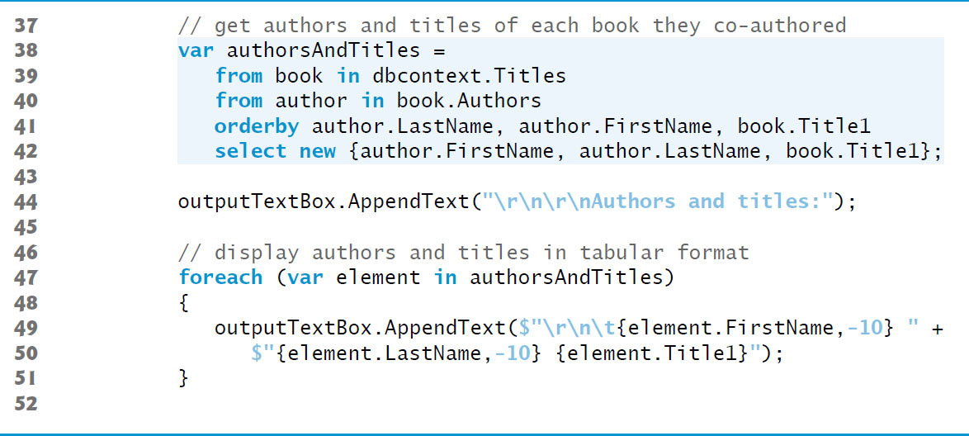
Figure 22.32 Getting a List of Authors and the Titles of the Books They’ve Authored

Slide 44
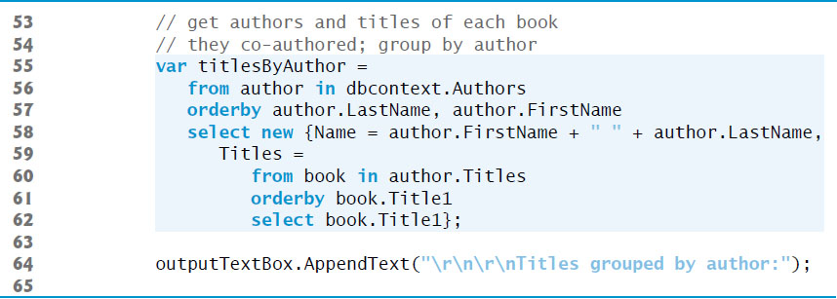
Figure 22.33 Getting a List of Titles Grouped by Authors (1 of 2)

Slide 45
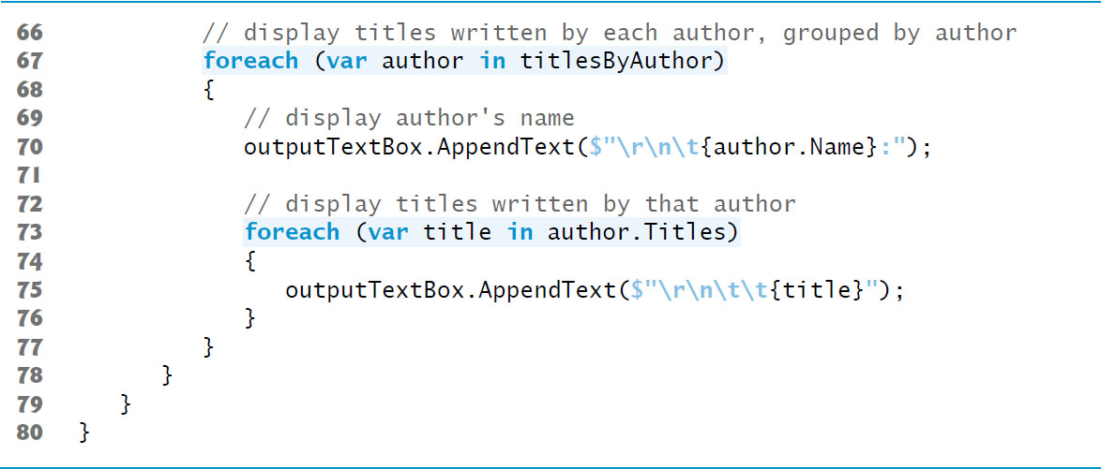
Figure 22.33 Getting a List of Titles Grouped by Authors (2 of 2)

Slide 46
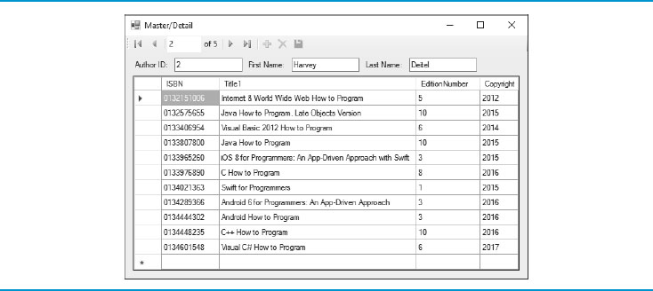
Figure 22.34 Master/Detail App Displaying Books for an Author in the Data Source

Slide 47
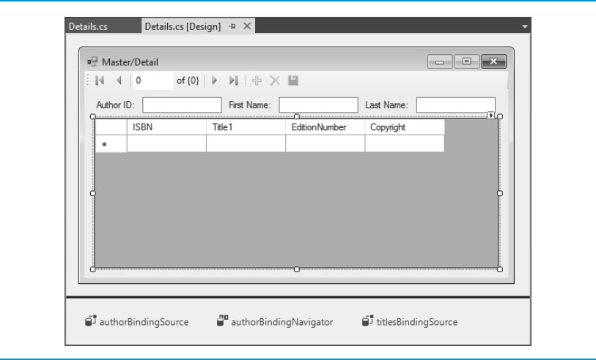
Figure 22.35 Finished Design of the Master/Detail App

Slide 48

Figure 22.36 Details Representation of an Author

Slide 49
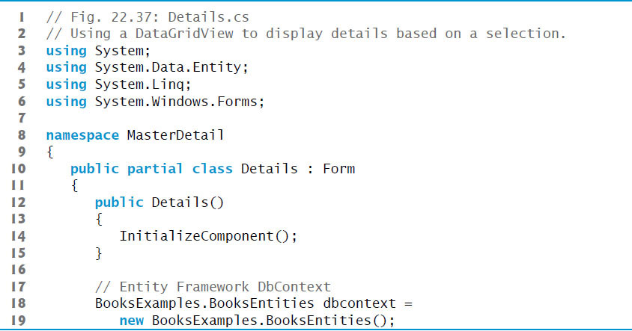
Figure 22.37 Using a DataGridView to Display Details Based on a Selection (1 of 2)

Slide 50
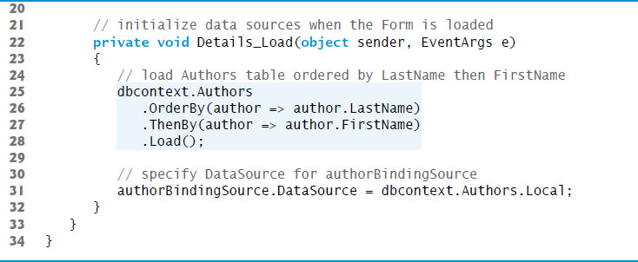
Figure 22.37 Using a DataGridView to Display Details Based on a Selection (2 of 2)

Slide 51
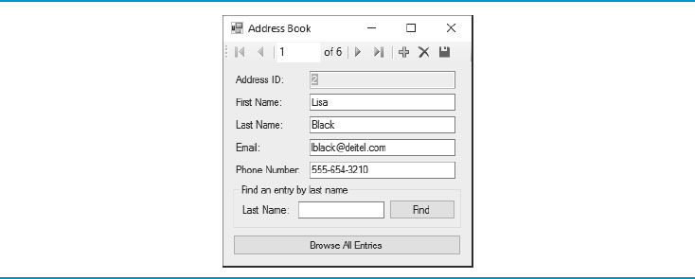
Figure 22.38 Use the BindingNavigator's Controls to Navigate Through the Contacts

Slide 52

Figure 22.39 Type a Search String in the Last Name TextBox, Then Press Find to Locate Contacts Whose Last Names Begin with That String
Only Two Names Start with Br, so the BindingNavigator Shows the First of Two Matching Records.

Slide 53
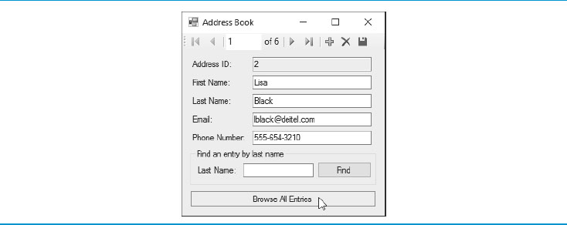
Figure 22.40 Click Browse All Entries to Clear a Search and Return to Browsing All Contacts

Slide 54
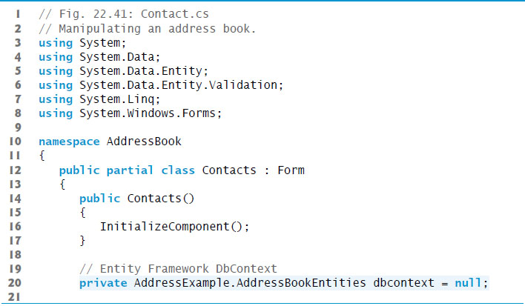
Figure 22.41 Creating the BooksEntities and Defining Method RefreshContacts for Use in Other Methods (1 of 2)

Slide 55
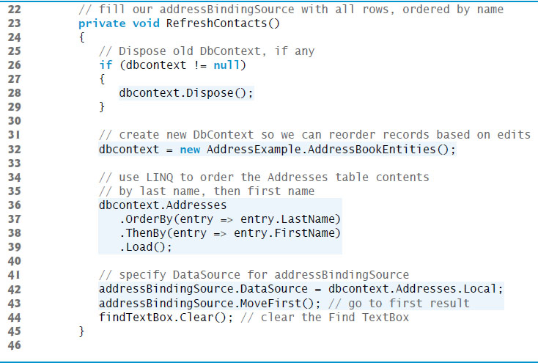
Figure 22.41 Creating the BooksEntities and Defining Method RefreshContacts for Use in Other Methods (2 of 2)

Slide 56
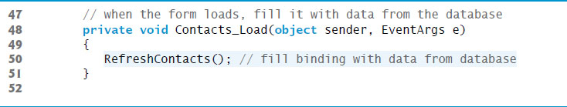
Figure 22.42 Calling RefreshContacts to Fill the TextBoxes When the App Loads

Slide 57
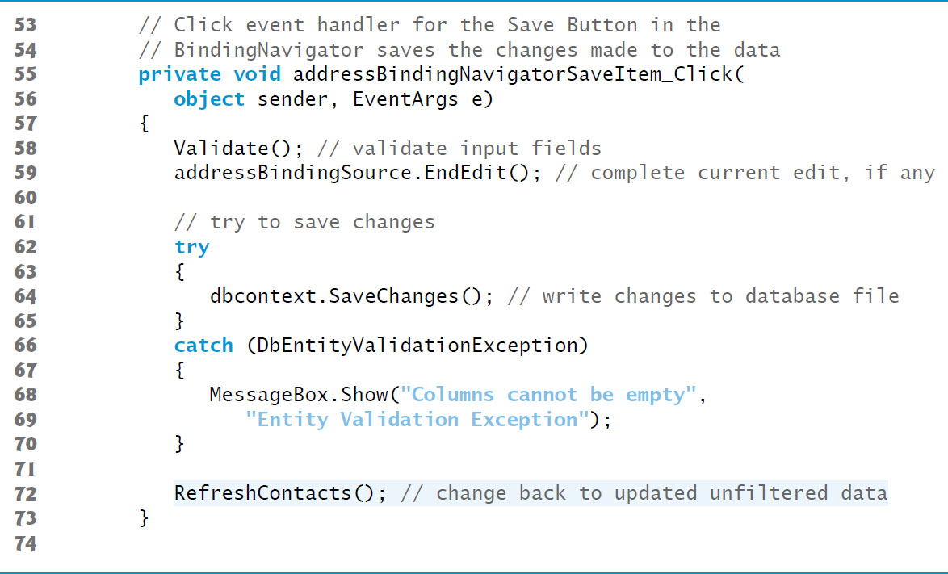
Figure 22.43 Saving Changes to the Database When the User Clicks Save Data

Slide 58
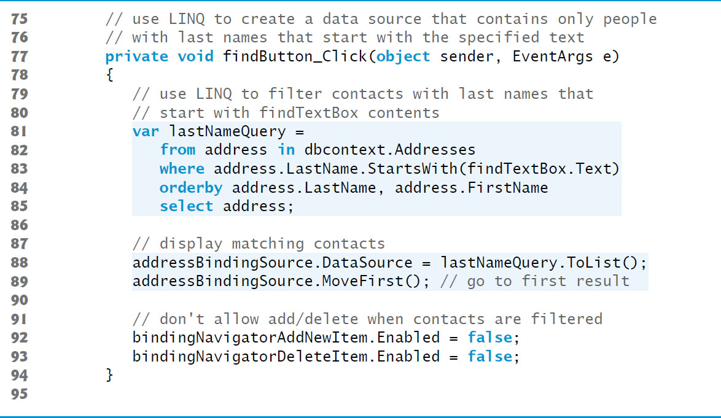
Figure 22.44 Finding the Contacts Whose Last Names Begin with a Specified String

Slide 59
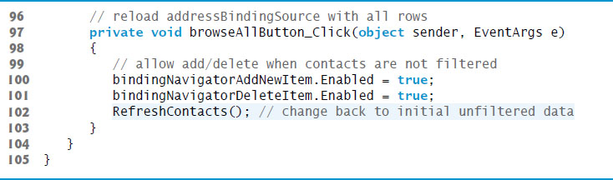
Figure 22.45 Allowing the User to Browse All Contacts

Slide 60

Copyright

